Slide 1


Computational Solution to the Air Pollution Physics & Chemistry in Modern Dense & Compact Cities
Chun-Ho Liu, Wai Chi Cheng, James Cheung, Tracy Chung
Cynthia Poon, Pei Shui and Colman Wong
Department of Mechanical Engineering, The University of Hong Kong
PRAGMA 17, October 28-30, 2009; IOIT, Hanoi, Vietnam
Correspondence: Chun-Ho Liu; Department of Mechanical Engineering, 7/F Haking Wong Building, The University of Hong Kong. Pokfulam Road, Hong Kong; Tel: (852) 2859 7901; Fax: (852) 2858 5415; liuchunho@graduate.hku.hk

Slide 2
Content
Simulation on the airflow around a cube
Pollutant dispersion in street canyons
Turbulent flow over & within vegetation canopies

Slide 3
Introduction
The air pollution physics & chemistry in urban areas are studied by computation fluid dynamics (CFD) method.
Large-eddy simulation (LES) & the Reynolds-averaged Navier-Stokes (RANS) k-ε turbulence
Open-source CFD code OpenFOAM-15 or -16
The programs are run in HPCPOWER2 Linux cluster of the Computer Centre, the University of Hong Kong
  24 blades 64-bit dual quadcore 3 GHz Xeon
  > 2.3 Tera-FLOPS (Theoretical Rpeak)
Extending to GRIDPOINT
  128 blades 64-bit dual quadcore 2.53 GHz Nehalem
  > 10.3 Tera-FLOTS (Theoretical Rpeak)
OpenMPI or MPICH for inter-processor communication

Slide 4
CFD of Turbulent Flow around a Cube
James Cheung

Slide 5
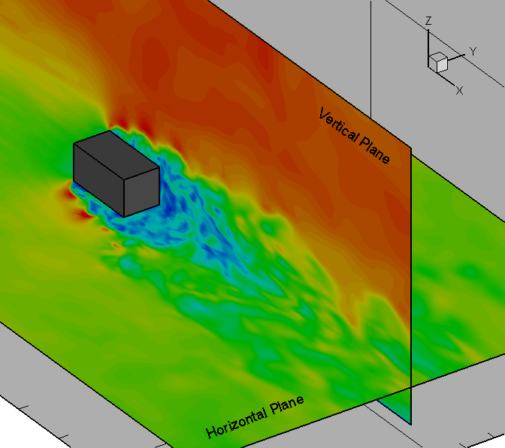
CFD of Turbulence Flow Around a Cube
HPCPOWER2 CPU Time:
84 hours
(for this animation)
About 100 days
(for scientific studies)
Wind flow direction
Cube
Wind flow direction
Variation of wind speed with time (Blue: low speed ; RED: high speed)

Slide 6
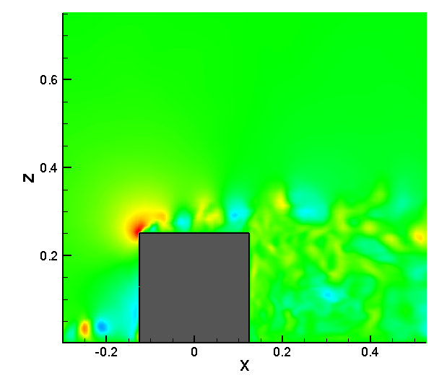
CFD of Turbulent Flow Around a Cube
HPCPOWER2 CPU Time:
84 hours
(for this animation)
About 100 days
(for scientific studies)
Wind flow direction
Cube
Small Circulations Developing
Cube
Variation of vertical velocity with time (Blue: going downward ; RED: going upward)

Slide 7
Pollutant Dispersion in
Street Canyon
WaiChi Cheng, Tracy Chung, Colman Wong & Pei Shui

Slide 8
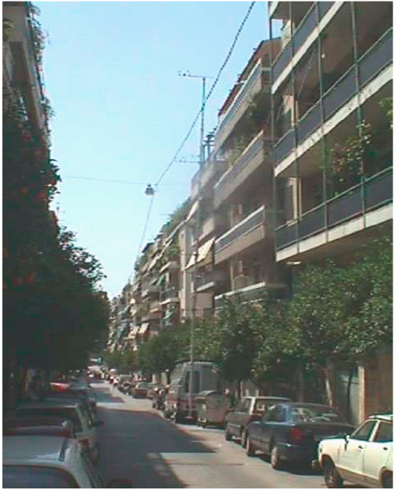
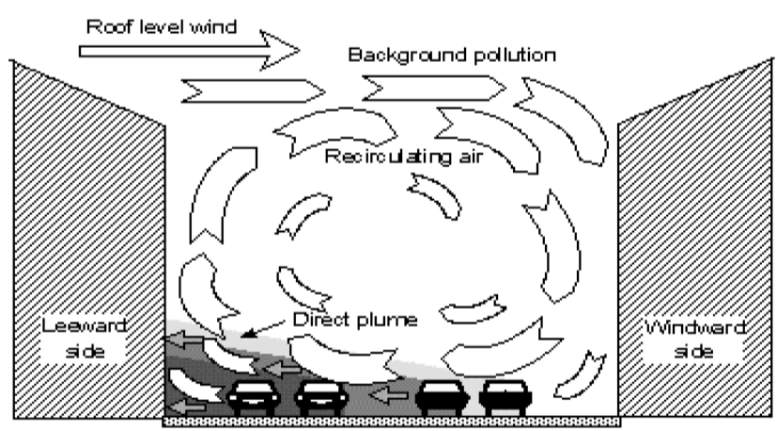
Background Information
Street canyon is formed by buildings and street which is common in urban areas.
Pollutant dispersion (from ground level) in street canyon is calculated by LES.
Intermittency on the pollutant transport
Berkowicz 2000
Niachou et. al. 2008

Slide 9
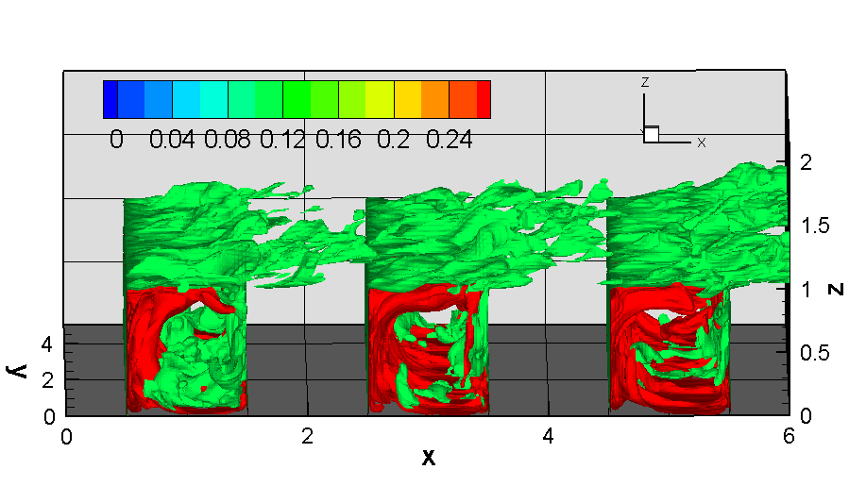
Narrow Street Canyon
14 million of node points
Run in 16 cores for 500 CPU hours.

Slide 10
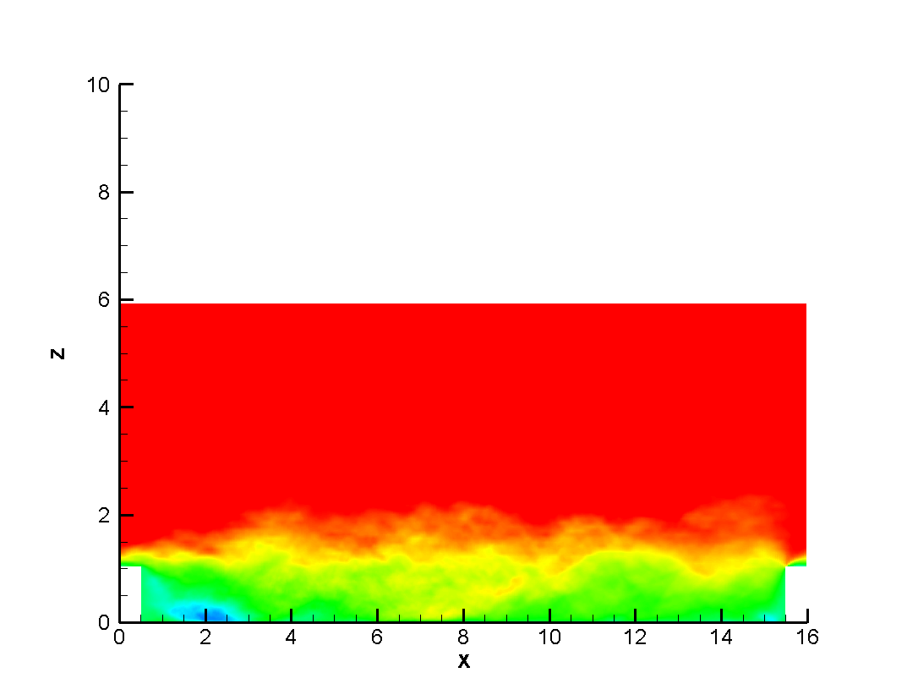
Wide street canyon
LES
Domain: 16m x 5m x 6m (7 million grids)
Pollutant sources in the ground, leeward, windward and roof

Slide 11
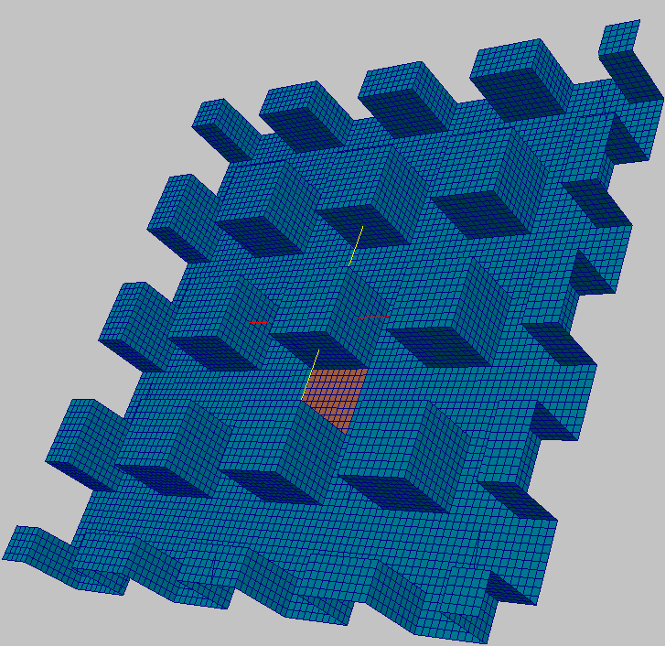
3-D Street Canyon
RNG k-ε model with wall functions
Constant Pollutant Concentration is red
Constant Pressure Gradient draw the flow in the domain across the periodic inlet/outlet

Slide 12


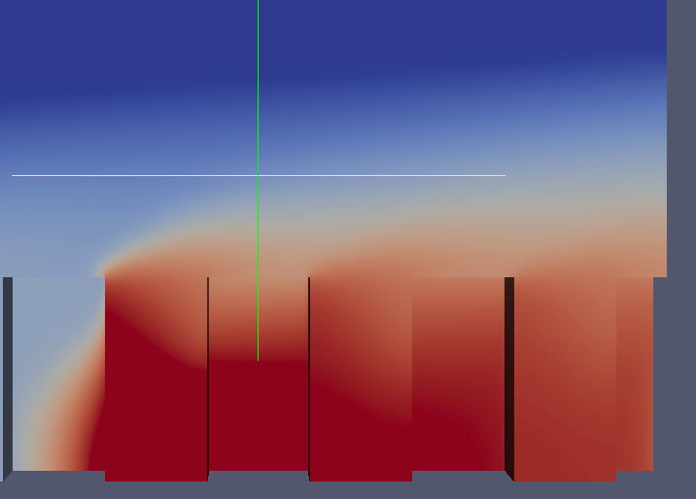
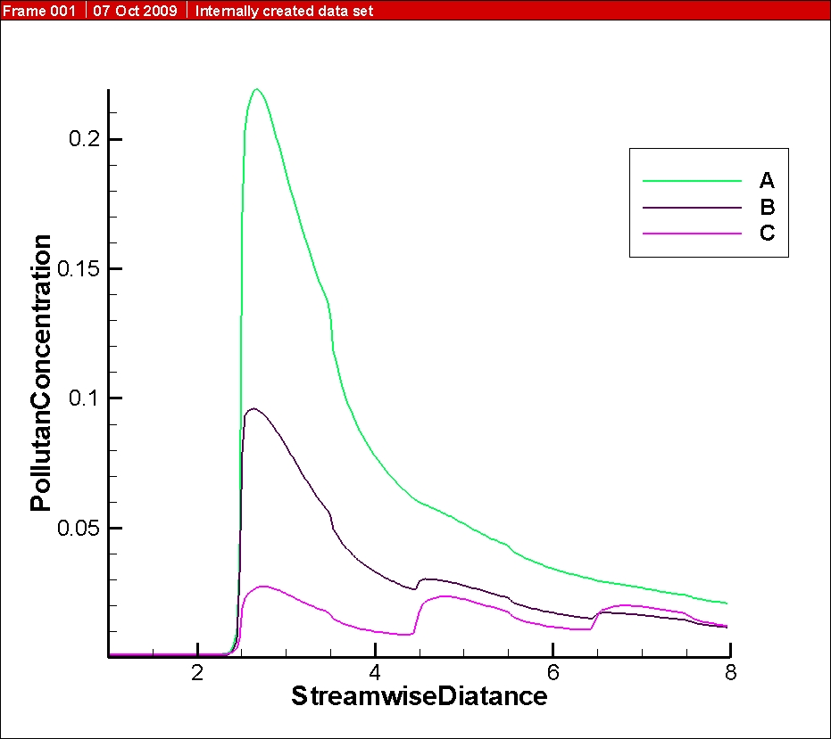
3-D Street Canyon - Results
A: Lower Building
B: Reference Building
C:Higher Building
Pollutant dispersion shown in vertical plane with different building height settings.
Streamwise Distance

Slide 13
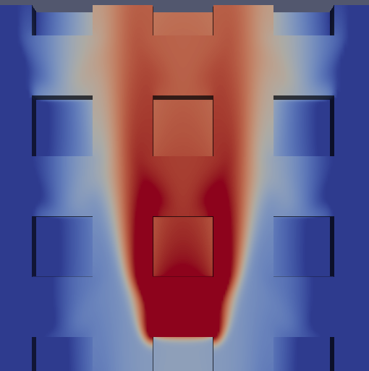
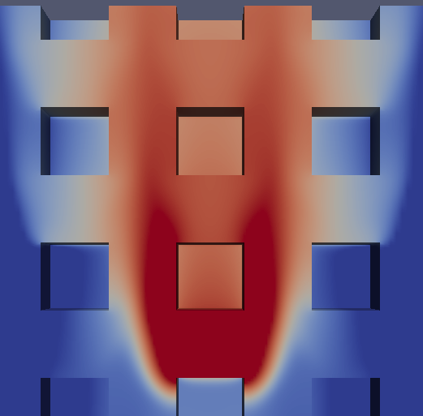

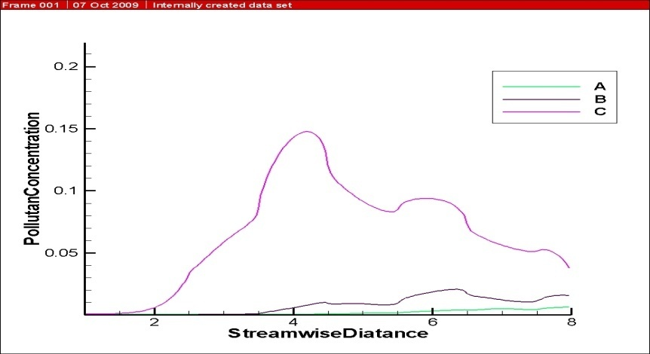
3-D Street Canyon - Results
A: Lower Building
B: Reference Building
C:Higher Building
Pollutant dispersion shown in horizontal plane with different building height settings.
Streamwise Distance

Slide 14
Pollutant Transport in the Urban Canopy Layer
Objective
  Depict the turbulent pollutant transport in the urban canopy layer by CFD
Required CPU time (with 16 cores)
  Used: 160 hours
  Remain: 1,000 hours

Slide 15
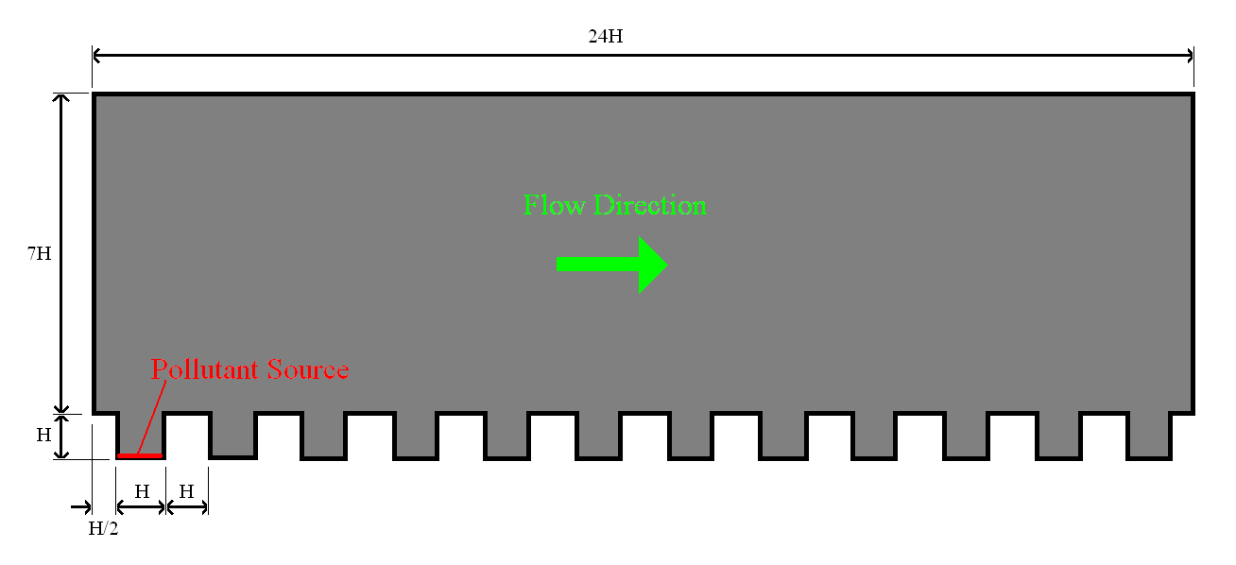
Domain Geometry
Number of element: 36M
LES
Reynolds number: ~12,000
Pollutant source: Constant concentration

Slide 16
Results

Slide 17
Air pollution chemistry
  LES
  Pollutant reactions in the ground level
    NO + O₃ → NO₂ + O₂
    NO₂ + O₂ → O₃ + NO

Slide 18
Turbulent Flow over and within Vegetation Canopy
Cynthia Poon

Slide 19

Methodology
Model: modified k-ε model (for porous media)
Domain: 500m200m100m
Mesh size: 1750000
symmetry
profile
zero gradient
Cd, a
wall function

Slide 20
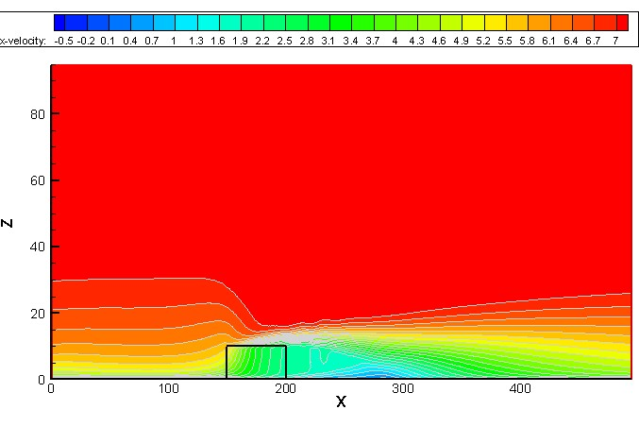
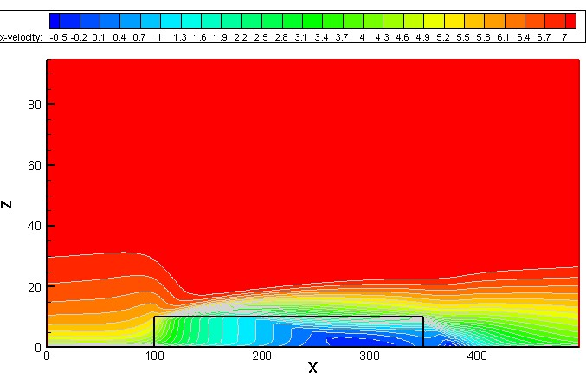
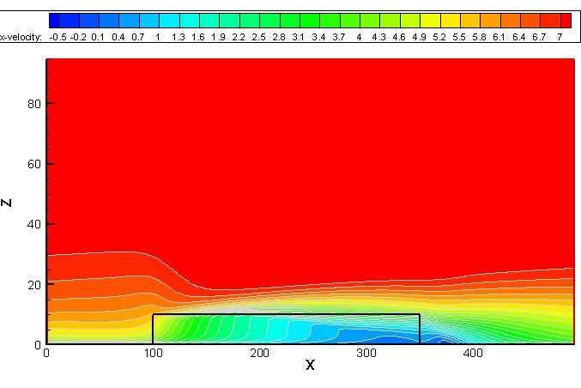
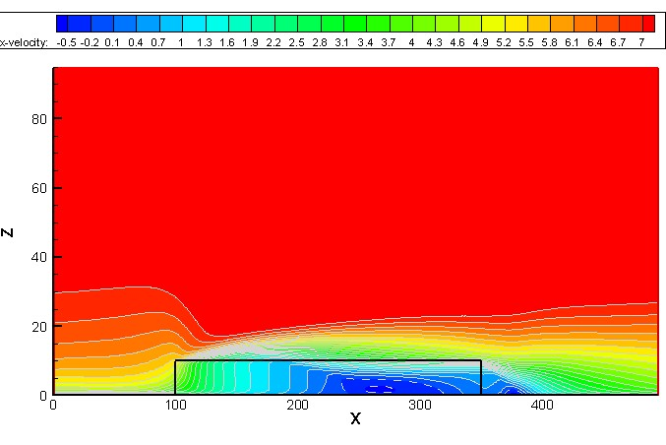
Results
Flow (U_{x}) with increasing canopy length (50→250m)
Flow (U_{x}) with increasing leaf area density (0.1→0.275m²m⁻³)

Slide 21

Acknowledgment
Research Grants Council (RGC), HKSAR
The University of Hong Kong
  Strategic Research Themes (SRT)
    Computational Science
    Environment & Sustainable Environment
  University Development Fund (UDF)
    Computational Science & Engineering
    HKU Initiative on Clean Energy & Environment
  Department of Mechanical Engineering
  Computer Centre
    Mr. Wing Keung KWAN
    Mr. Frankie T.F. CHEUNG
  Long-term mutually successful collaboration since 1990

